Slide 1
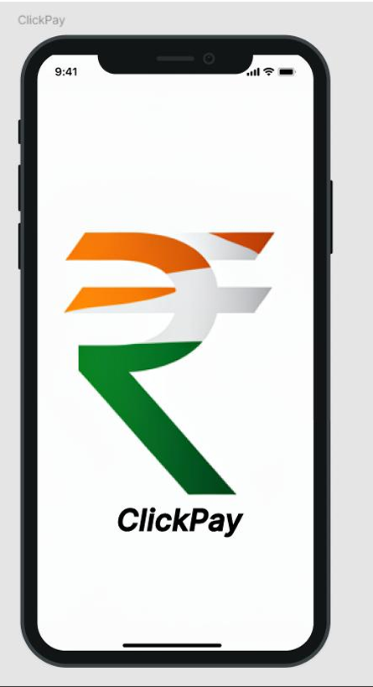
ClickPay App – Mobile Computing Lab Experiments Overview
Welcome to an overview of the ClickPay app, a practical exploration in mobile app development using React Native and Firebase. This presentation, prepared by Atul in 2025, details the experiments and learnings from building a multi-screen payment application. Join us on a journey from basic UI design to Firebase authentication, culminating in a functional app ready for future enhancements.
by Aryan Surve

Slide 2
Basic UI Design
Objective
Impact
Understand UI structure and responsive layout principles using React Native components.
Established a strong UX foundation for crucial screens like payment, dashboard, and user profile.
Tools
Result
React Native components like View, Text, Button, Image for building the base layout.
Constructed a base layout for ClickPay with a professional and visually appealing design.
The design phase focuses on creating an intuitive interface that enhances user engagement and simplifies navigation. The visual components are carefully chosen to ensure accessibility and appeal.

Slide 3
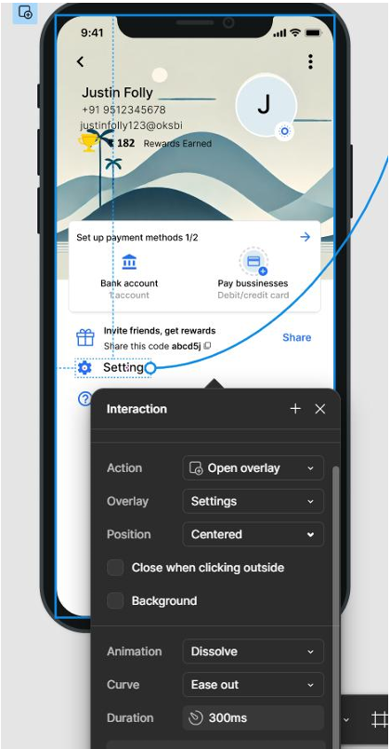



Implementing Animations
Explored
Fade-in/out, Slide, Rotate, and Bounce effects using React Native's Animated API.
Applied On
Landing transitions, button presses, and quick action cards to enhance user experience.
Learning
Animations significantly enhance interactivity, provide user feedback, and draw attention to important actions.
Animations were strategically implemented to not only make the app more visually appealing but also to provide clear feedback to user interactions, resulting in a smoother, more engaging experience.

Slide 4
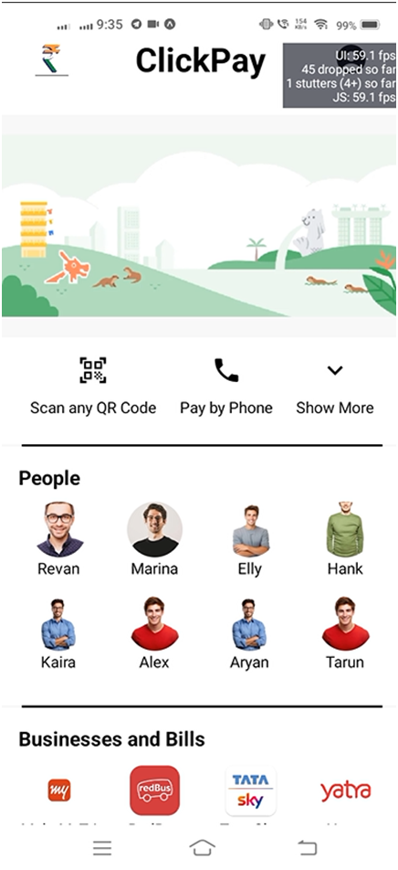
Navigation & Multi-Screen Flow
Tools Used
Screens Implemented
React Navigation (Stack Navigator) for managing app navigation.
Landing
Dashboard
Profile
Pay by Phone
Payment
Flow
Enabled smooth transitions between screens with intuitive header control and gesture support.
Effective navigation is the backbone of app usability. React Navigation was leveraged to create a seamless user journey throughout the ClickPay app, making each feature easily accessible and enhancing overall satisfaction.

Slide 5




Data Input & Storage
Storage
Components
Utilizing local state for immediate feedback and Firebase integration for persistent data storage.
Implementing forms, modals, and asynchronous interactions to manage data flow.
Key Learning
Focus
Designing secure and intuitive methods for capturing user data while ensuring data integrity.
Capturing user input through text fields and touchable components.
2
3
1
4
Secure and efficient data handling is crucial for any payment app. This slide highlights the methods used to capture, validate, and store user data, ensuring both a smooth user experience and robust data security.

Slide 6
RESTful API Integration
Result
Tools
Enabled real-time updates and seamless synchronization with backend data.
fetch and axios libraries were used for making API calls.
1
2
3
Example
Fetching user data, contact lists, and available recharge options from the server.
API integration is pivotal for connecting the UI with backend systems. By integrating RESTful APIs, the ClickPay app ensures that users receive up-to-date information, enhancing the app's utility and reliability.

Slide 7
Firebase User Authentication
Method
1
Implemented phone number authentication using Firebase.
Error Faced
2
Encountered auth/argument-error due to AsyncStorage absence.
Solution
3
Utilized initializeAuth with getReactNativePersistence to resolve the issue.
User authentication is critical for securing the app. Firebase provides robust authentication mechanisms, and this slide details the setup process, the challenges faced, and the solutions implemented to ensure secure access.

Slide 8
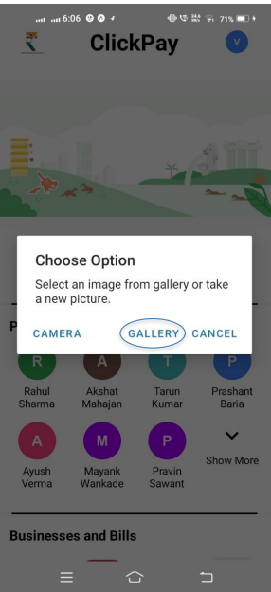



Multimedia & Device Features
Multimedia
Integrated image loading in splash screen and dashboard for an enhanced visual experience.
Device Integration
Utilized Async Storage, SMS fallback, and search with filters to leverage device capabilities.
Performance
Optimized for Android responsiveness to ensure a smooth user experience.
Enriching the app with multimedia elements and device feature integrations enhances user
engagement and utility.
This slide details how ClickPay integrates these features while maintaining optimal performance.

Slide 9
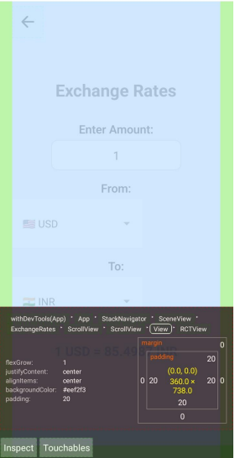
UI Testing & Final Insights
Testing
Challenges
Manual testing was conducted across various devices to ensure compatibility and responsiveness.
Dependency conflicts, reCAPTCHA issues, and Firebase debugging presented significant challenges during development.
Result
The outcome is a working multi-screen payment app with an intuitive design, ready for further enhancements.
Thorough testing is essential for delivering a stable and reliable app. This slide summarizes the testing process, the challenges encountered, and the future scope for enhancing ClickPay with additional features and integrations.

